Slide 1



SQL FUNDAMENTALS
Alibek Kruglikov

Slide 2

AGENDA
Databases and SQL
Anatomy of a Query
Order of Execution
Debugging a Query

Slide 3
Databases and SQL

Slide 4
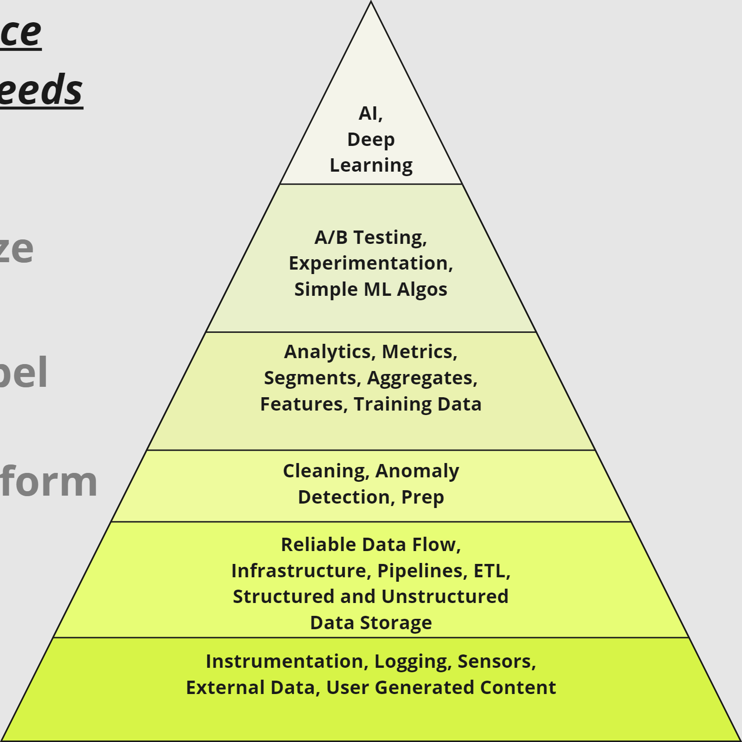
DATA SCIENCE HIERARCHY OF NEEDS
Learn
Optimize
Aggregate / Label
Explore / Transform
Move / Store
Collect

Slide 5
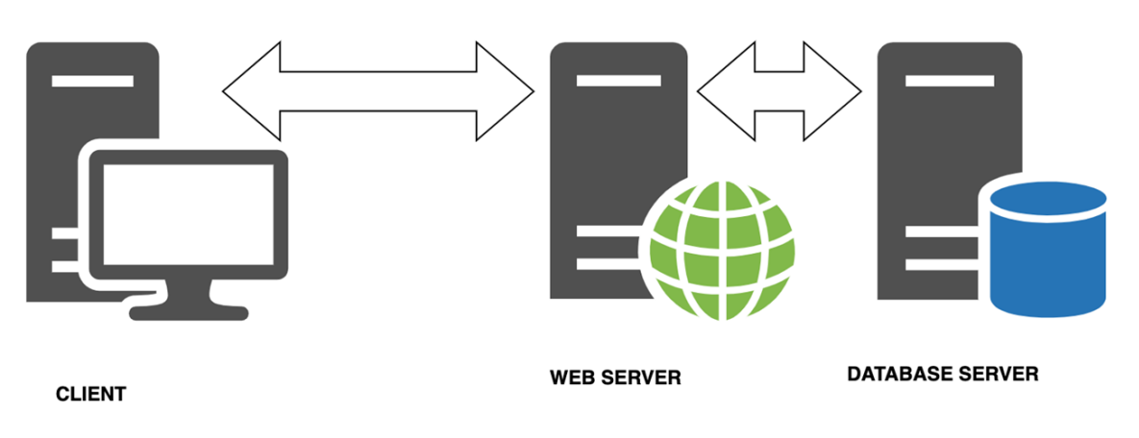
THREE TIER ARCHITECTURE
What happens when you visit a website?

Slide 6

DATABASE MANAGEMENT
Different software to manage and communicate with databases, we are using PostgreSQL:
Other SQL “flavours” are similar
Open source
Flexible and relatively easy to use
pgAdmin can be used for more human-friendly UI
https://www.pgadmin.org/docs/pgadmin4/latest/index.html

Slide 7
PSQL DATA TYPES
https://www.postgresql.org/docs/current/datatype.html
Most important for now:
Integers (int): whole numbers
Double precision (float): number with decimals
Varchar: text string
Boolean: True / False

Slide 8
Anatomy of a Query

Slide 9
ANATOMY OF A QUERY
SELECT [ columns and functions ]
[ FROM from_item ]
[ WHERE condition ]
[ GROUP BY [ ALL | DISTINCT ] grouping_element ]
[ HAVING condition ]
[ ORDER BY expression [ ASC | DESC ] ]
[ LIMIT [ count | ALL ] ]
[ OFFSET start [ ROW | ROWS ] ];

Slide 10
Order of Execution

Slide 11
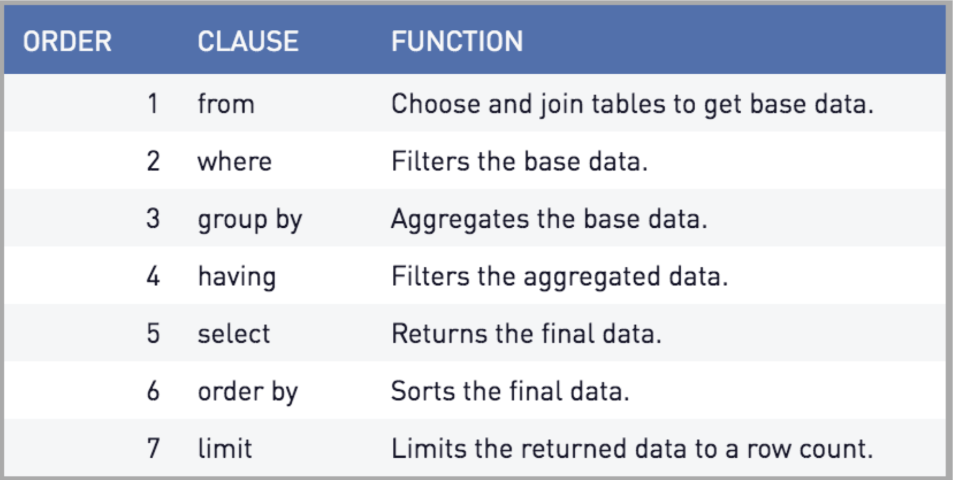
ANATOMY OF A QUERY

Slide 12
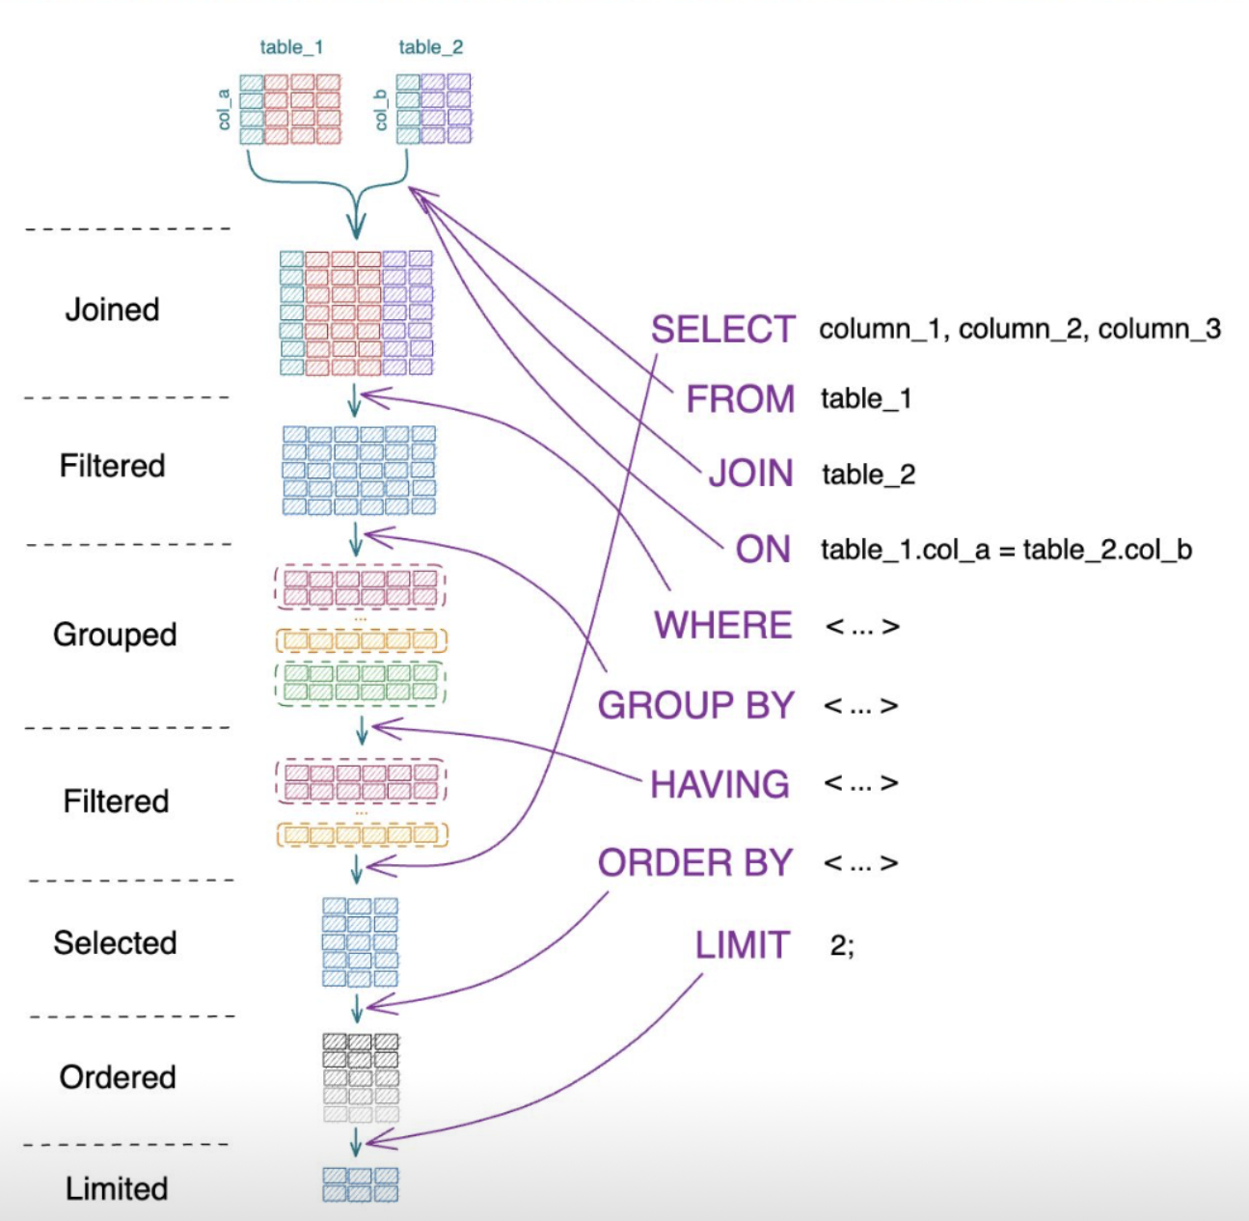
ANATOMY OF A QUERY

Slide 13
Debugging a Query

Slide 14
COMMON ERRORS
Error: syntax error at or near…
Locate the error
Check for typos
Check order of execution
Check brackets / semicolons
Column does not exist
Check for typos
Check aliases
Permission denied for relation…
Correct user / password / database?

